Slide 1

DIAMOND PRICE PREDICTION
Presented by:
Manan Patel
Nawaraj Adhikari

Slide 2

PROBLEM STATEMENT
The diamond industry heavily relies on accurate price prediction to ensure fair trade and optimal business operations.
Diamonds are priced based on a variety of attributes, including size, cut, clarity, color, and other physical characteristics. However, the non-linear relationships among these factors, combined with outliers and data inconsistencies, make price prediction a challenging task.
This project aims to build a machine learning model to accurately predict the price of diamonds using a dataset of diamond attributes.
The dataset includes numerical and categorical features, some of which require cleaning and feature engineering to uncover meaningful insights.
The final objective is to evaluate the performance of multiple predictive models, including linear regression, polynomial regression, decision trees, and random forests, to identify the best approach for accurately predicting diamond prices.

Slide 3
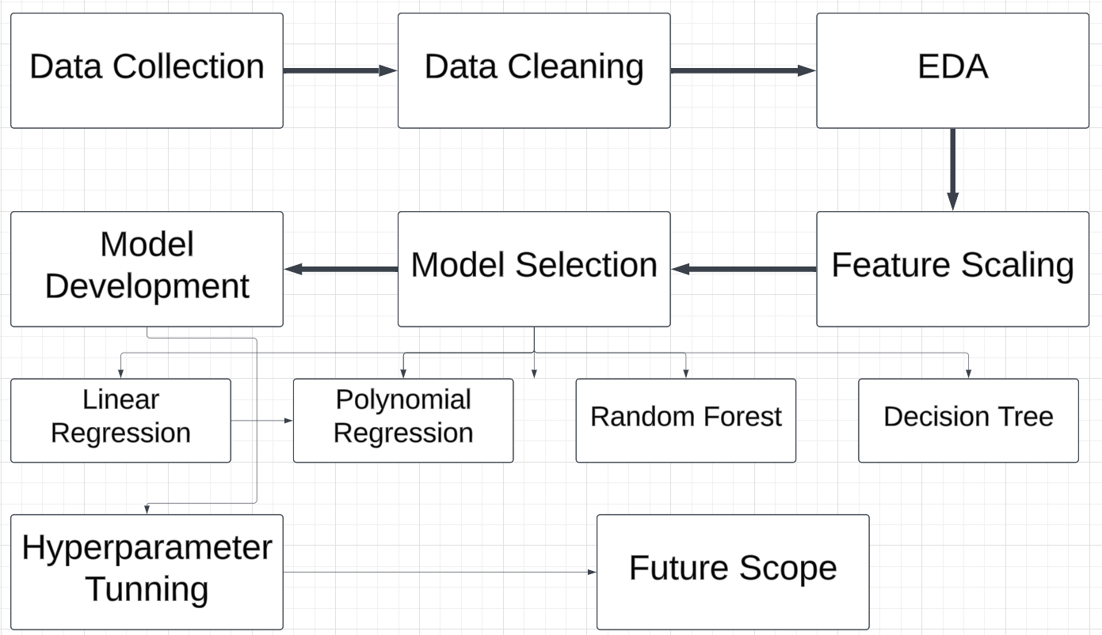
WORKFLOW FOR PROJECT

Slide 4
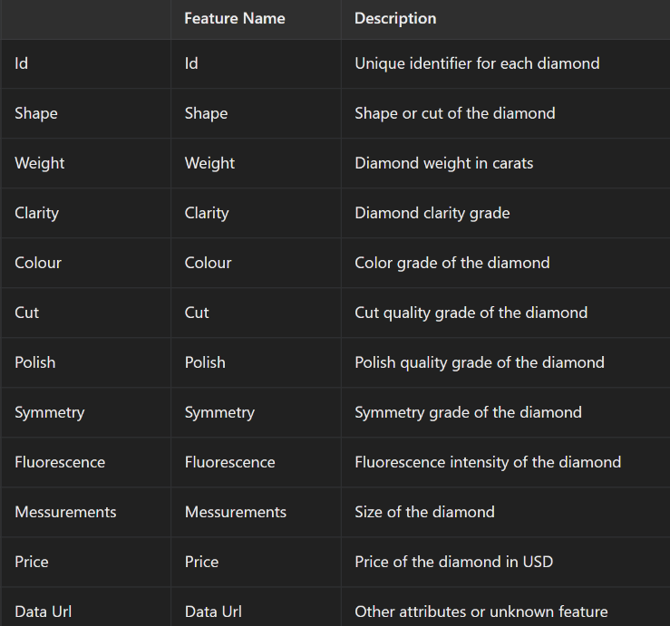
DATASET OVERVIEW
Total Number of Rows : 2141 Data Source : SRK Company
Number of Features : 12
Target Variable : Price

Slide 5
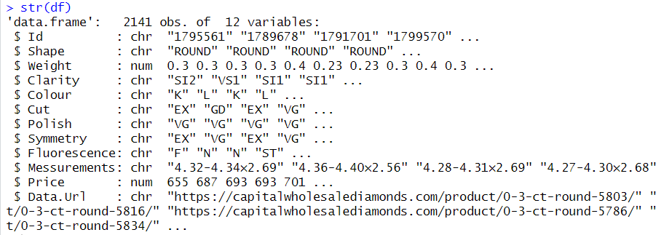
DATATYPE OF FEATURES

Slide 6
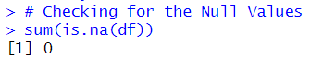
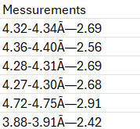
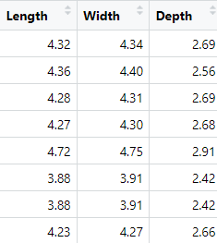
DATA CLEANING
Checking For Missing Values
Checked for missing or null values in the dataset. Confirmed no missing values were present
Creating 3 New Columns using the Messurements column and dropping the data Url Column:
Length
Width
Depth
Before:
After:

Slide 7
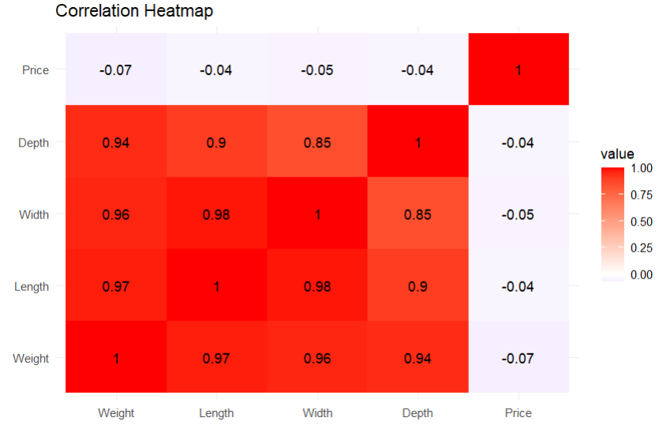
EDA (EXPLORTORY DATA ANALYSIS)
Correlation Heatmap
The heatmap highlights the relationship between features and the target variable (Price).
Key insights:
Dimensions (Length, Width, Depth, Weight) are strongly correlated.
Price has minimal correlation with these dimensions.

Slide 8
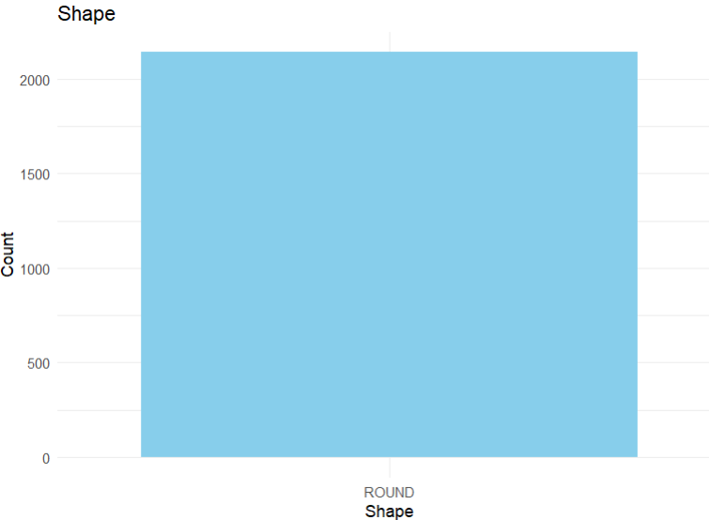
SHAPE
The bar chart shows that all diamonds in the dataset have a ROUND shape, indicating no variability in this feature.
Since the Shape feature lacks diversity and does not contribute to predicting price, we will remove it from the dataset to reduce redundancy.

Slide 9
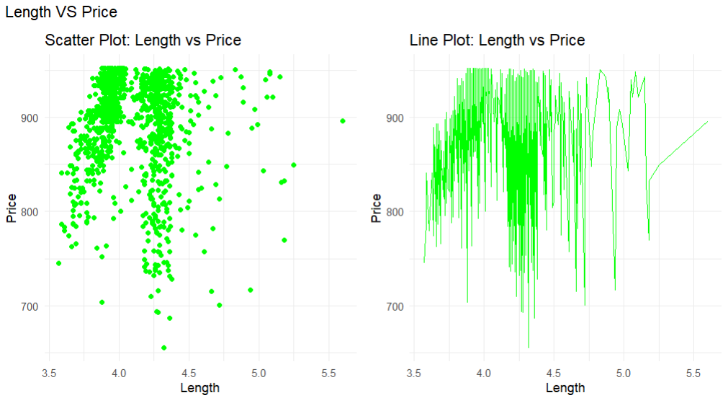
PRICE VS LENGTH
The scatter plot indicates no clear linear relationship between length and price, showing a scattered distribution.
But we can see high decrease in price when Length between (4.75-5.00)
Also Price is increasing after approx 5.25

Slide 10
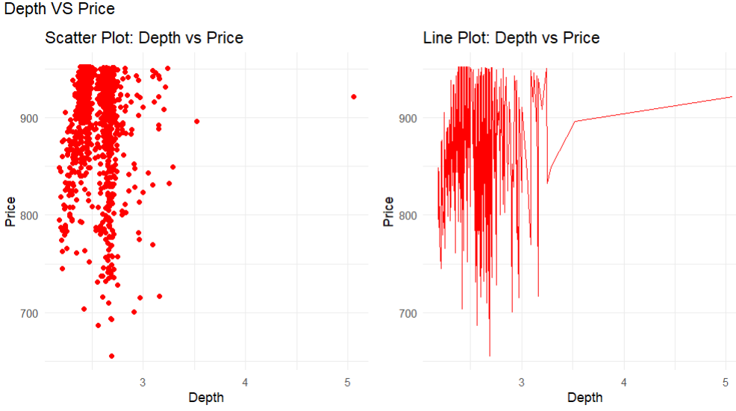
PRICE VS DEPTH
The scatter plot shows no evident linear relationship between depth and price, with the data points being widely spread.
The line plot indicates significant price fluctuations, particularly in the range of depths between 2.5 and 3.5.

Slide 11
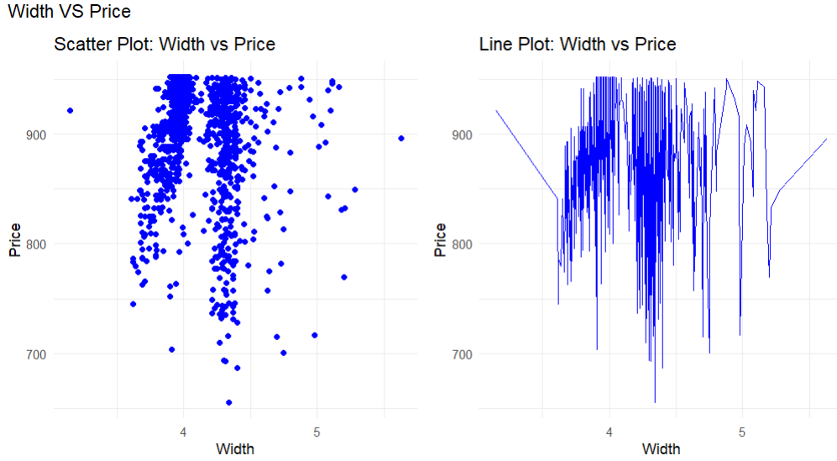
PRICE VS WIDTH
The scatter plot demonstrates no clear linear relationship between width and price, with the data points scattered across a wide range.
The line plot shows sharp price fluctuations, especially between widths of 4.0 and 5.0.

Slide 12
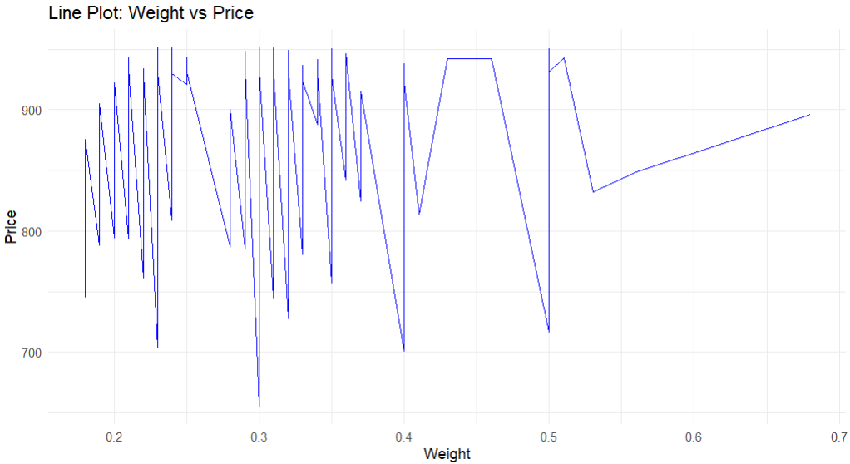
PRICE VS WEIGHT
The line plot exhibits significant fluctuations in price across the weight range, indicating a lack of a consistent trend.
A noticeable increase in price is observed for weights beyond 0.5 carats, suggesting higher valuation for heavier diamonds.

Slide 13
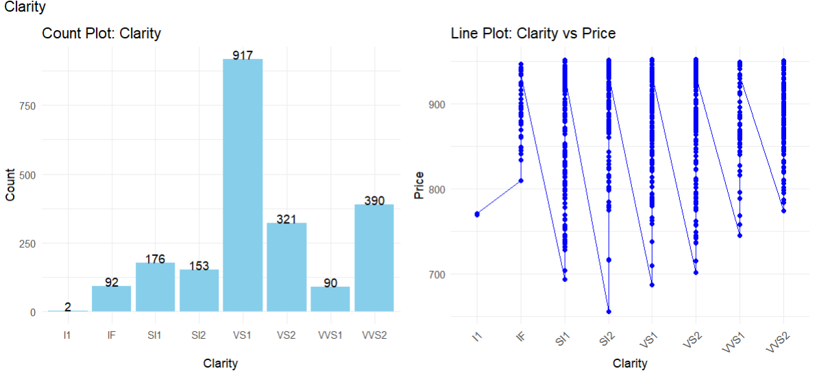
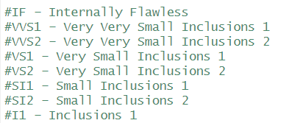
CLARITY
The count plot shows that most diamonds have a clarity grade of VS1, while I1 has the least occurrences.
The line plot indicates that price generally varies significantly across different clarity grades, with some grades like IF showing higher prices.
We will Combine the least ones to create a 'Other' as feature.

Slide 14
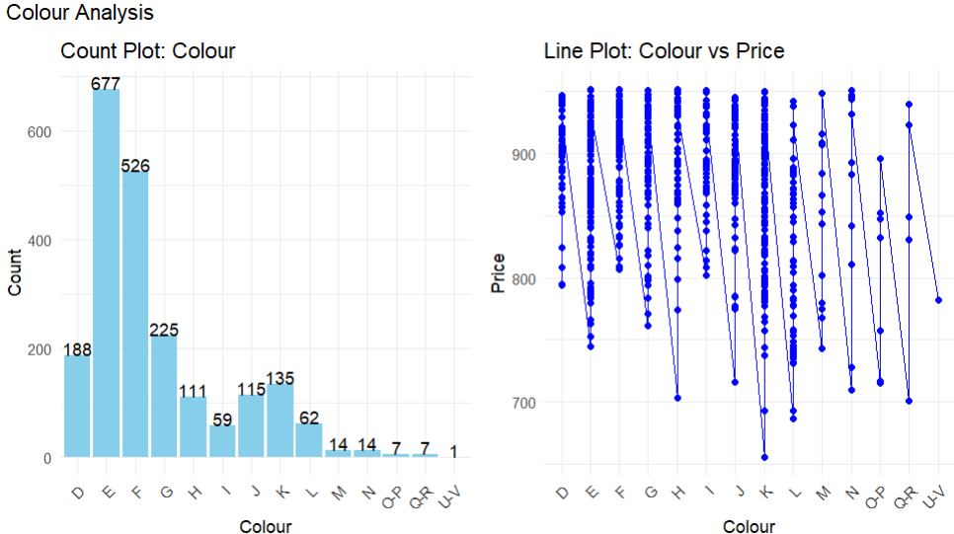
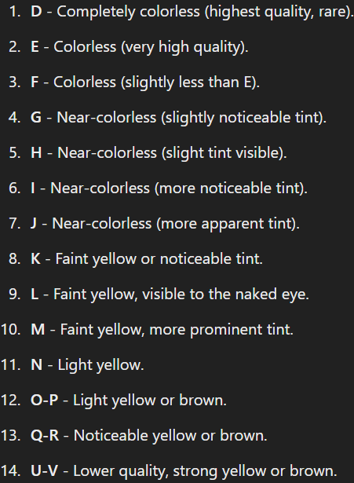
COLOUR
The count plot indicates that the most common diamond color grades are E and F, while grades like N, O-P, Q-R, U-V are rare, with very few occurrences.
The line plot shows price variations across different color grades, with higher prices typically associated with D, E, and F grades.

Slide 15
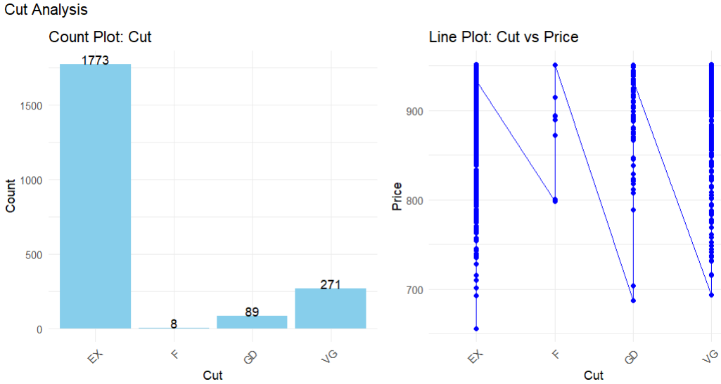
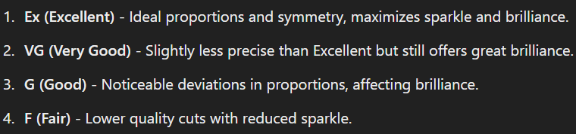
CUT
The count plot reveals that the majority of diamonds have an Excellent (Ex) cut, while the other categories like Fair (F) and Good (G) have significantly fewer instances.
The line plot shows that diamonds with an Excellent cut generally fetch higher prices compared to other cut categories.

Slide 16
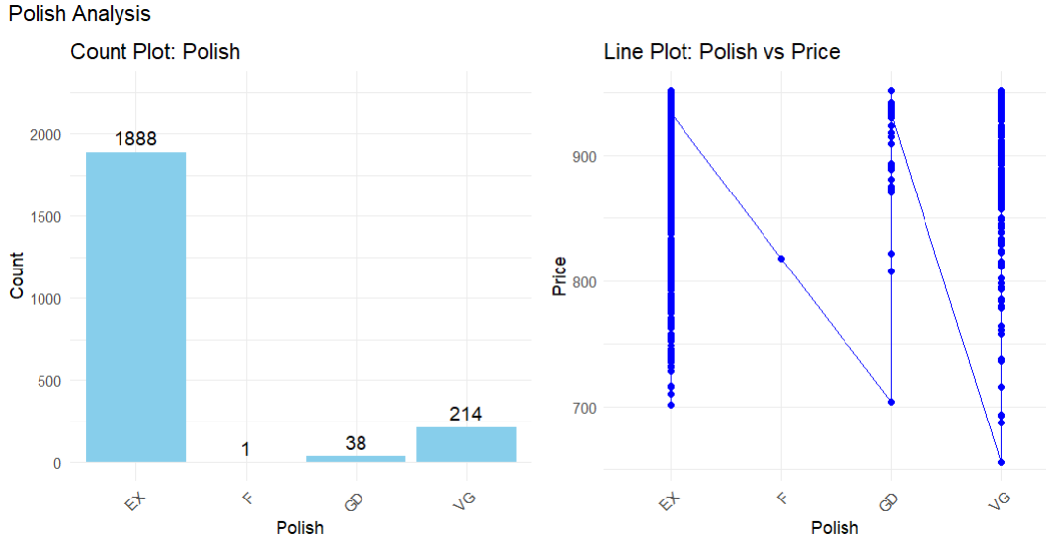
POLISH
The count plot reveals that the majority of diamonds have an Excellent (Ex) polish, with very few diamonds in the other categories like Fair (F) and Good (G).
The line plot indicates that diamonds with Excellent (Ex) polish generally achieve higher prices compared to those with lower polish grades.

Slide 17
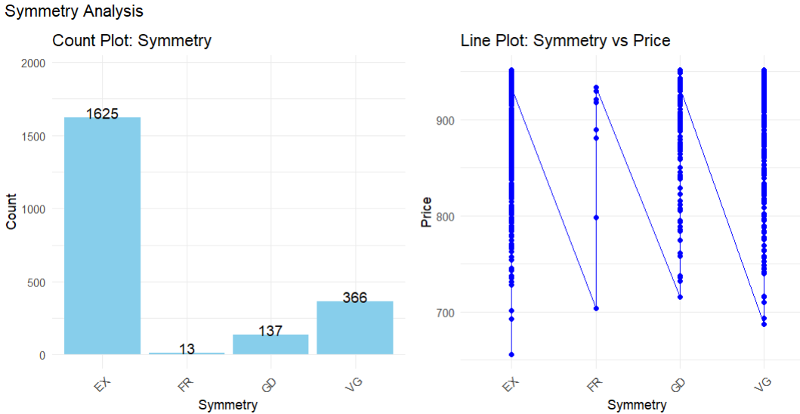
SYMMETRY
The count plot shows that most diamonds have Excellent (Ex) symmetry, while categories like Fair (FR) and Good (G) have significantly fewer instances.
The line plot indicates that diamonds with Excellent (Ex) symmetry tend to have higher prices compared to those with lower symmetry grades.

Slide 18
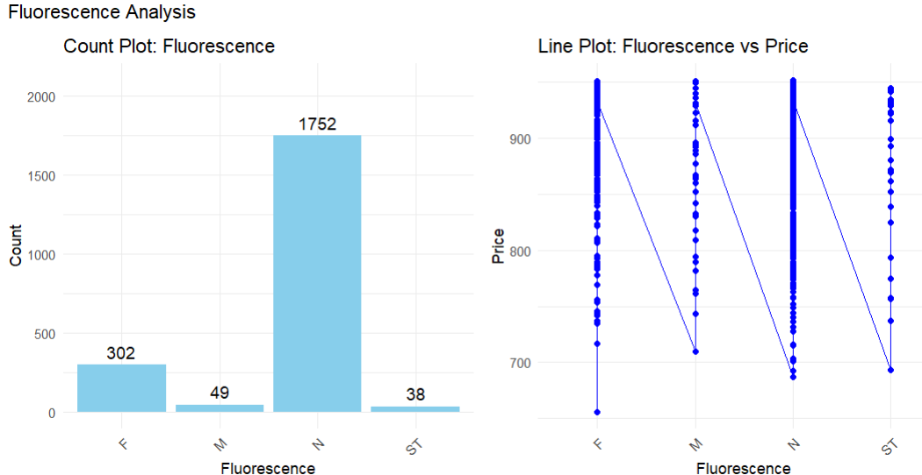
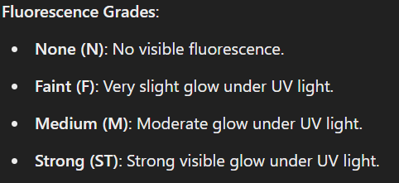
FLUORESCENCE
The count plot shows that most diamonds have None (N) fluorescence, while categories like Medium (M) and Strong (ST) have significantly fewer instances.
The line plot indicates that diamonds with Faint (F) fluorescence tend to have higher prices compared to other fluorescence categories.

Slide 19
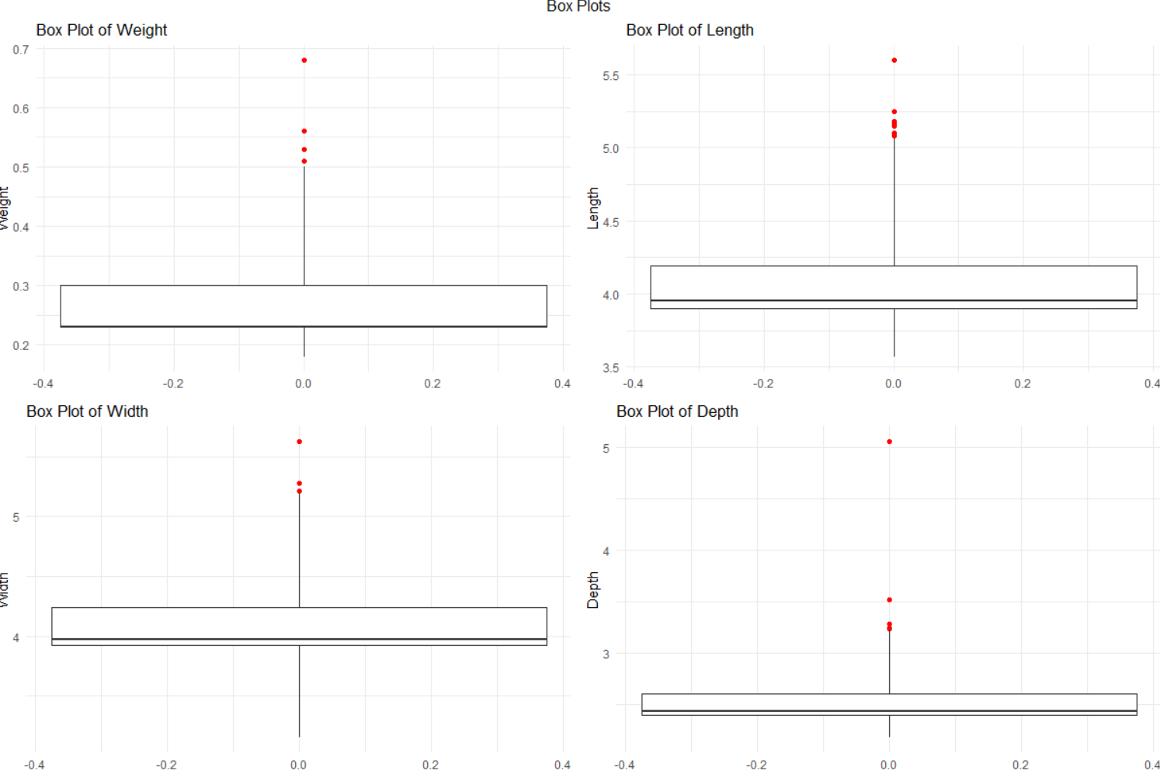
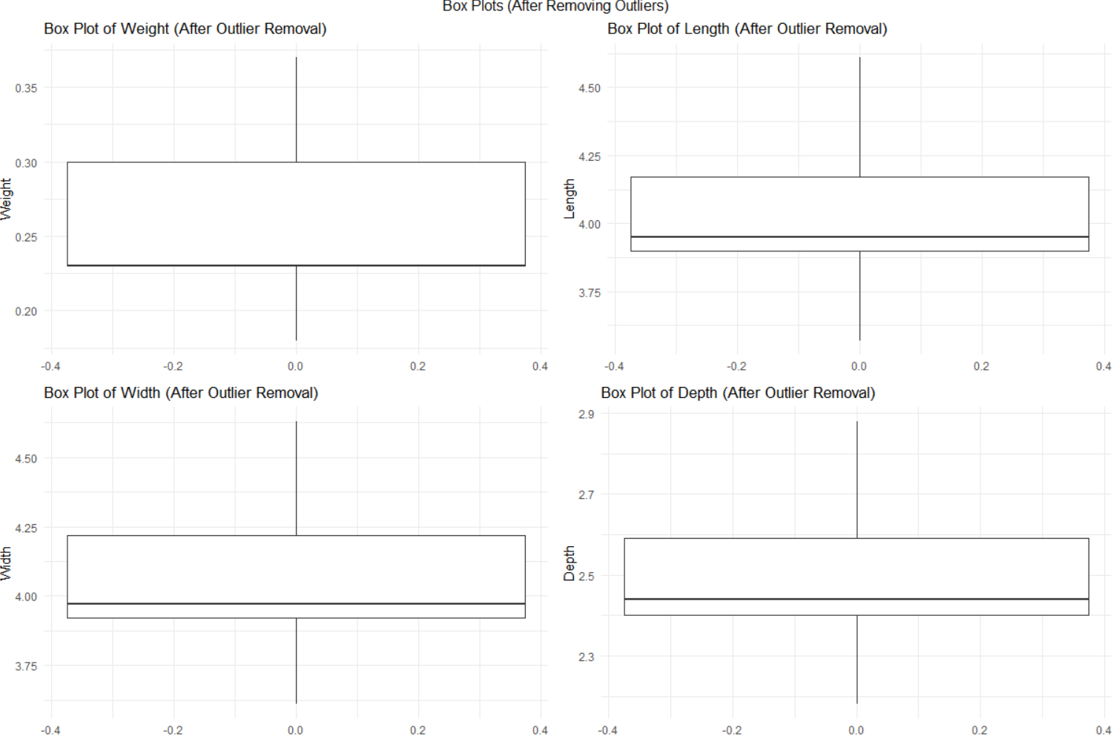
DEALING WITH OUTLIERS
Before Outlier Removal: The box plots on the left show the presence of several outliers in the features Weight, Length, Width, and Depth, which extend significantly beyond the whiskers of the plots.
After Outlier Removal: The box plots on the right indicate that the outliers have been successfully removed, resulting in a more compact distribution of values within the interquartile range for all features, enhancing the dataset's quality for analysis

Slide 20
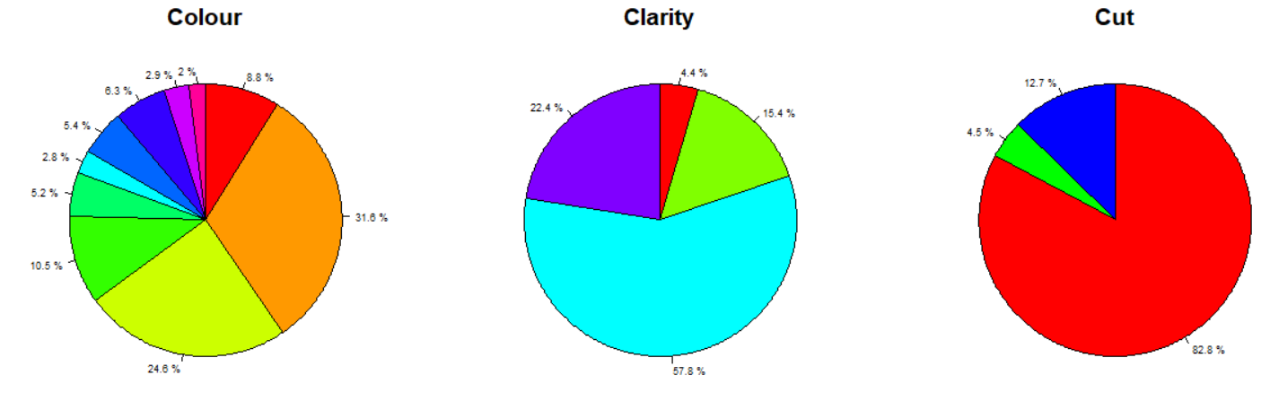
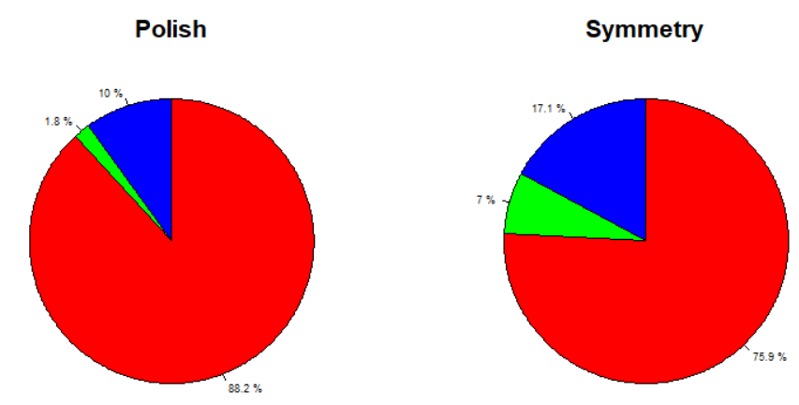
FEATURE ENGINEERING
Combining the features with minimum count as 'Other' in this columns:
Colour
Clarity
Cut
Polish
Symmetry
Replaced the rare category "F" (Fair) with "GD" (Good).
Combined "N“,"M“, "O-P“, "U-V“ and "Q-R" under the category "Other.“
Merged "VVS1" and "VVS2" into a single category named "VVS.“
Merged "SI1" and "SI2" into a single category named "SI.“
Merged "VS1" and "VS2" into a single category named "VS."
Combined rare clarity levels "IF" and "I1" into the category "Other."

Slide 21
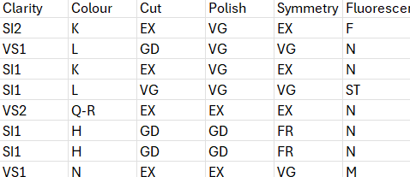
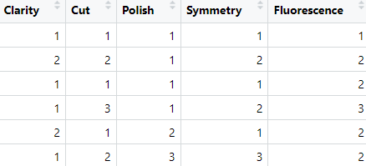
FEATURE SCALING
The categorical features Clarity, Cut, Polish, Symmetry, and Fluorescence were converted to numerical values using label encoding to make them suitable for machine learning models.
The Colour column was one-hot encoded to ensure each unique category is represented as a separate binary feature, improving compatibility with models sensitive to categorical hierarchies.
Before:
After:

Slide 22
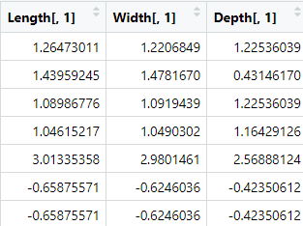
STANDARDIZATION
The numerical features (Weight, Length, Width, and Depth) have been standardized using scaling to ensure all values are on the same scale.
This is essential for improving model performance and avoiding bias due to feature magnitude differences.
Before:
After:

Slide 23
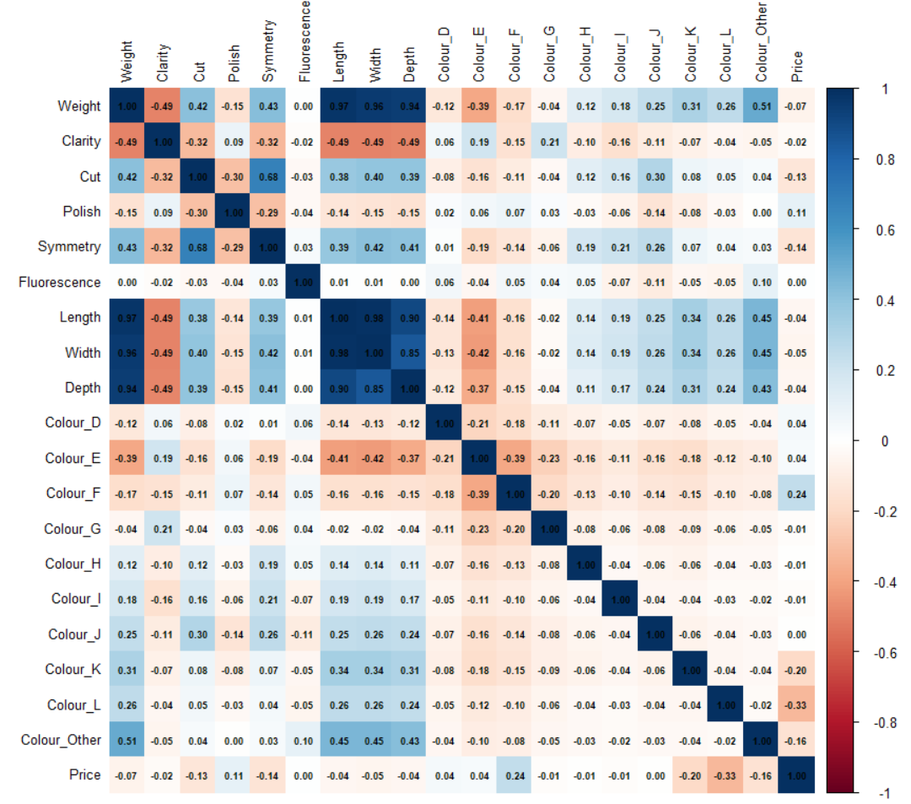
CORRELATION MATRIX
Price is mostly related with this columns:
Cut
Polish
Symmetry
Flourescene
Colour

Slide 24
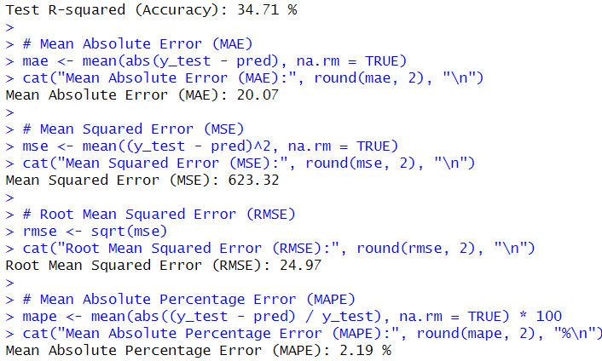
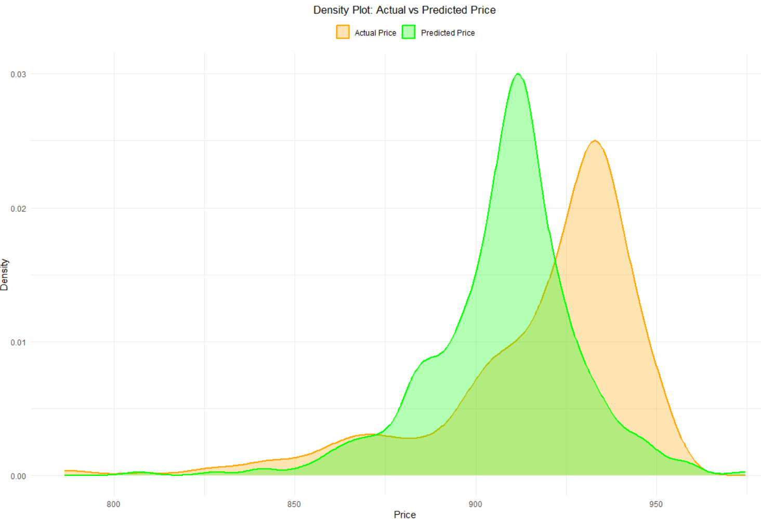
MODEL SELECTION
Linear Regression Model

Slide 25

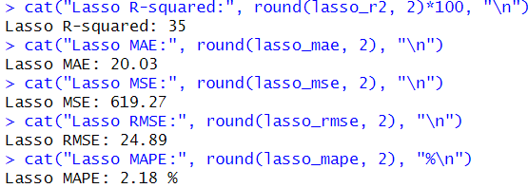
MODEL SELECTION
Lasso Regression Model

Slide 26
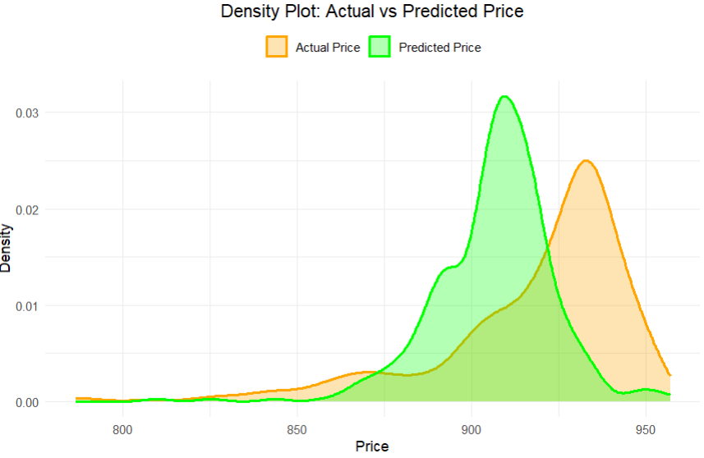
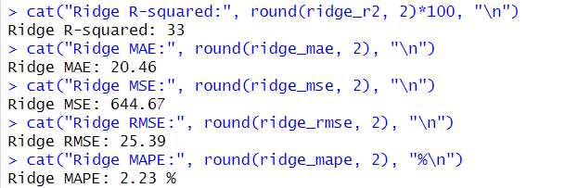
MODEL SELECTION
Ridge Regression Model

Slide 27
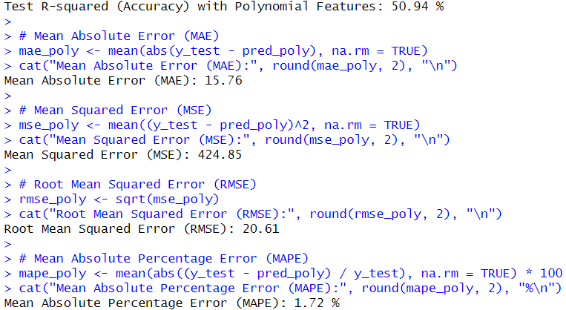
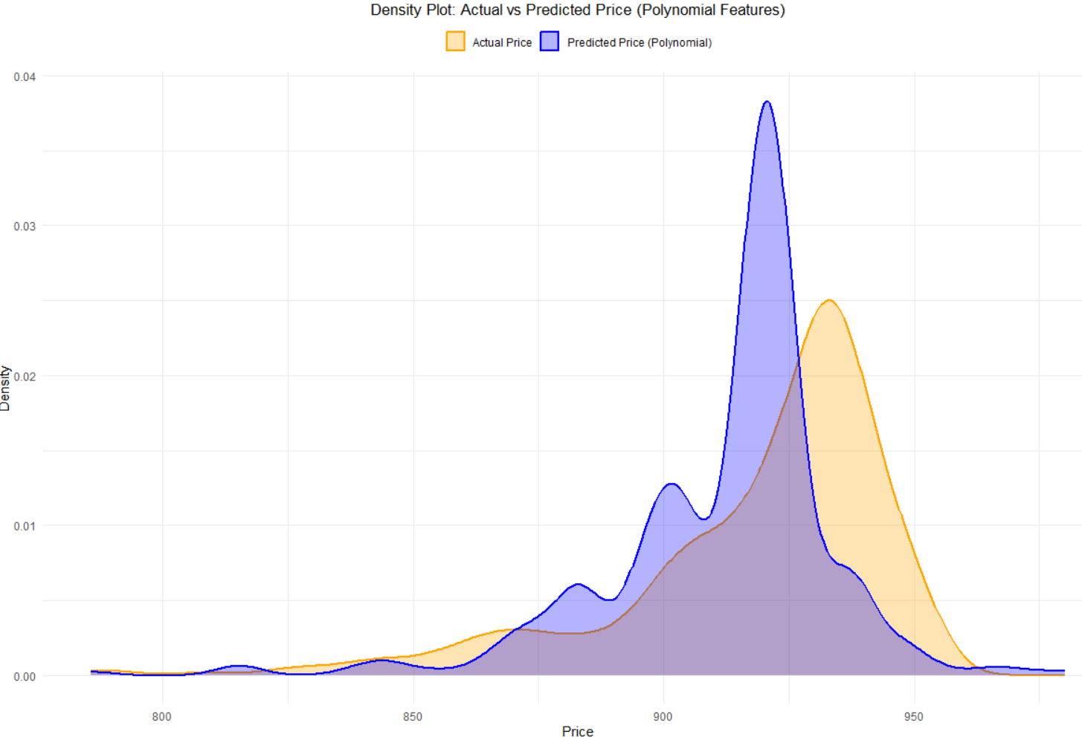
MODEL SELECTION
Polynomial Regression
At Degree 2 the accuracy(R-Squared) was 46.19%
At Degree 3 the accuracy(R-Squared) was 49.83%
At Degree 4 the accuracy(R-Squared) was 50.94%

Slide 28
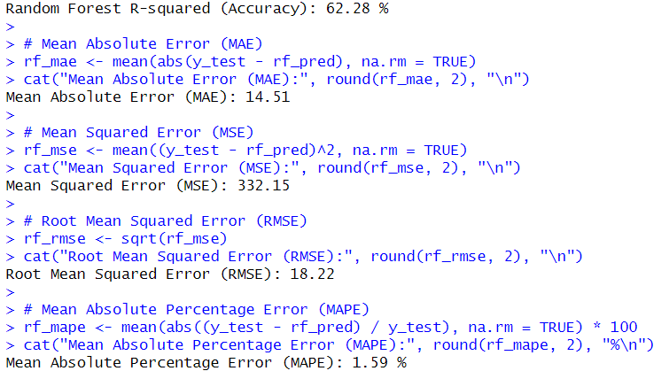
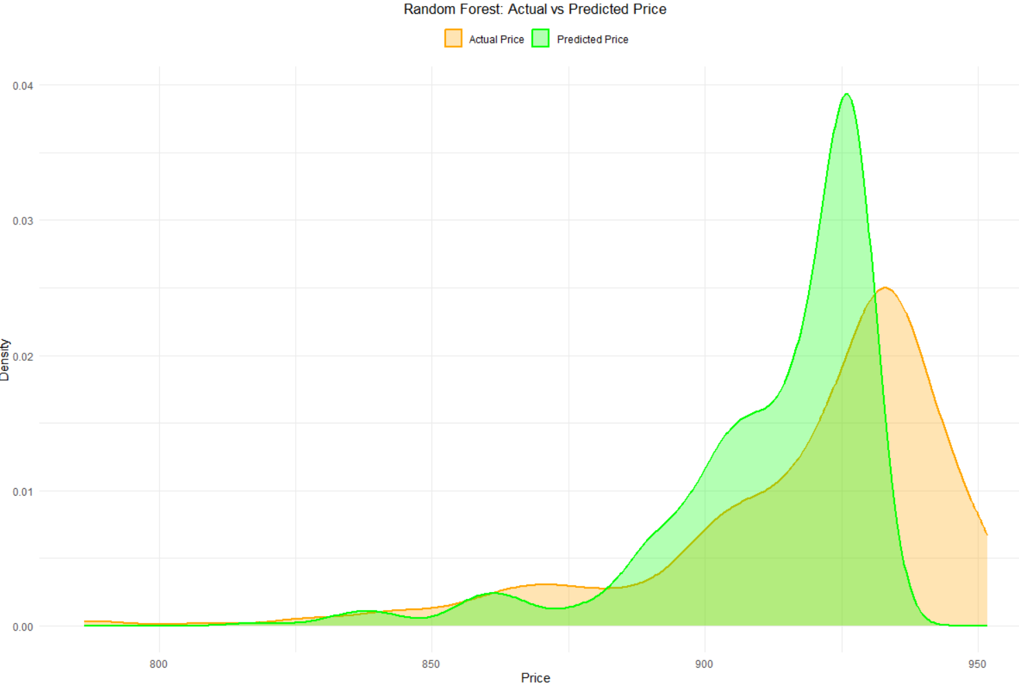
MODEL SELECTION
Decision Tree we got R Squared score equals to 46.66%
When we applied Random Forest then we got R Squared Score equals to 62.28%

Slide 29
CONCLUSION
Effective preprocessing and feature engineering, including handling outliers, encoding categorical variables, and scaling numerical features, improved model performance and ensured better data quality.
Random Forest and Polynomial Regression (higher degree) performed better in terms of R², RMSE, MSE and MAE, showcasing the importance of capturing non-linear relationships and interactions between features.
Important Features: Factors like Clarity, Cut, Polish, Symmetry, and Fluorescence played significant roles in predicting price.
Relationships between Length, Width, and Depth with price were non-linear, necessitating polynomial and tree-based models for better prediction.

Slide 30
FUTURE SCOPE
Integration of Real-Time Market Trends
Incorporation of Advanced Machine Learning Models (XGBoost, LightGBM, or Neural Networks)
Customer Personalization
Geographical Pricing Models

Slide 31
REFERENCES
R Core Team (2023). R: A Language and Environment for Statistical Computing. R Foundation for Statistical Computing. Available at: https://www.r-project.org
Towards Data Science: Guide to Machine Learning Models in R. Available at: https://towardsdatascience.com
Stack Overflow discussions for resolving specific implementation issues.
https://www.kaggle.com/

Slide 32


